Slide 1
Economic Analysis of Groundwater Use Patterns and Environmental Justice Considerations
Zoey Reed-Spitzer
Thesis Defense
May 8th, 2024

Slide 2
Depth to Water* (DTW) Data Usefulness in Economic Analysis
Groundwater (GW) supply threatened in many regions worldwide
Only some areas regulate GW use
Political, legal, & technical factors inhibit reporting requirements
This study examines usefulness of DTW data to understanding linkages between GW conditions & economic, regulatory, & climate factors
*Distance from land surface to water table (relates to GW levels)
Notes:
##Why only some parts regulated? Political and legal factors inhibit requirements and accuracy of reporting GW use.
##Population and housing increased by 11.9% and 8.9% & agricultural sector continues to grow (sources)

Slide 3
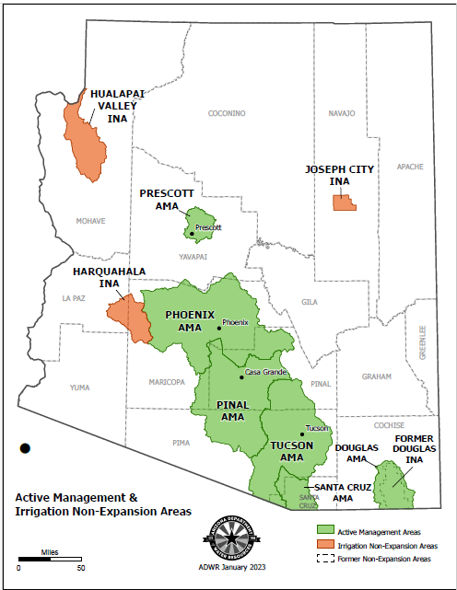
Arizona’s GW Scarcity Mitigation Efforts
1980 GW Management Designation
All designated sub-basins reliant on GW
Pumping permit, conservation, & reporting requirements
No monitoring or reporting requirements exist outside of regulated areas
Artificial GW recharge projects
Underground storage & GW savings facilities
Entities’ water stored, up to 50% required to be recharged (42)
Central Arizona Project authorized 1968
1.5 million acre-feet served to 80% AZ population (43)
Notes:
GW Management Designation: All designated areas very reliant on GW and were found responsible for 70% of overdraft at the time
- Conservation mainly relates to restrictions on agricultural expansion and implementing best management practices programs to increase water use efficiency
End: Many of these regulations and projects focused on large municple areas in state, leaving rural communities with big ag that uses majority of GW in the state vulnerable to GW scarcity

Slide 4
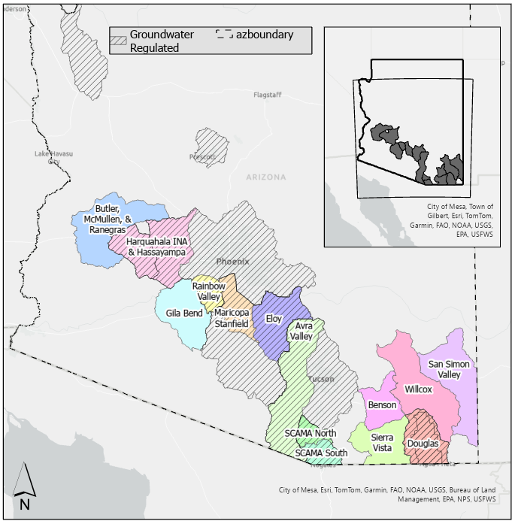
Study Area
Criteria for Sub-basins Chosen
Elevation below 5000 feet for similar cropping patterns
At least 5% of acreage of human activity is agriculture
GW dependent
Rural identity – No major cities
GW regulated in 8 out of 14 sub-basins
Notes:
ADWR defines subbasin as hydrologically distinct bodies of underground water. I use these to determine my study area.
##Mention all cropland irrigated here

Slide 5
GW Economics Literature
Climate factors and GW pumping influence DTW changes (1,2)
Studies mostly occur in large municipal or agricultural areas
GW use data lacking around the globe (3)
Water demand price inelastic (4, 5, 6, 7, 8)
Decoupling trend found between population growth and GW use in large municipalities (9)
Notes:
Price inelastic: for both Municipal and Ag side: Water saving toilets, efficient washing machines, & landscape rebates explored instead (8)

Slide 6
GW Economics Literature
Efforts made to estimate GW use
hydrologic & demand-based modeling, remote sensing estimation, land cover estimation, and electricity use as a proxy (11, 12, 13, 14, 15, 16)
Methods require varying levels of data & availability varies by region (11)
This study adds literature on rural GW use by identifying relationships between economic, climate, & regulatory factors and DTW
Notes:
##incorporating factors that directly relate to GW use to determine relationship between them and DTW changes

Slide 7

Drivers for Sub-basin GW Demand
Agricultural drivers for water demand
Energy cost to pump GW & other input prices (ex. Alfalfa seed price)
Crop Mix & Fallowing
Common crops in study area: alfalfa, cotton, & tree crops – water intensive
Fallowing requires significantly less water
Environmental factors
Hotter temperatures and less precipitation requires higher demand for irrigating crops
Municipal drivers for water demand
The number of people demanding water
Indoor & outdoor water use behavior
Notes:
Begin: Now to determine what to include in the economic analysis, it is important to consider drivers of sub-basin GW demand.
Agricultural drivers: ag uses 74% of all water supply in the state, of which 42.9% GW in 2015
- Land Use: Because crops in study are water intensive, planted acreage can be a good indicator for GW demand
Municipal water demand a smaller proportion but still relevant to consider
End: Understanding drivers of GW use and demand helps inform what variables should be included in the econometric analysis

Slide 8
Variable | Definition | Units | Source
Depth to Water (DTW)* | Distance from ground surface to top of water table in well | Feet | ADWR Ground Water Site Inventory (GWSI)
Temperature | Mean temperature | Celsius | PRISM Climate Group Gridded Dataset
Precipitation | Mean precipitation | Inches | PRISM Climate Group Gridded Dataset
Per Capita Income | Average income per person | U.S. Dollars | US Census Bureau ACS – five year moving average estimates
Housing Units | Average housing units | Count | US Census Bureau ACS – five year moving average estimates
Planted Acreage | Irrigated cropland amount | Acres | Cropland Data Layer’s CropScape
Recharge | Whether sub-basin has active recharge project in particular year | Dummy | ADWR USF permitted storage volume table
Regulation | Whether sub-basin is groundwater regulated | Dummy | ADWR Designation
*DTW is the dependent variable
Notes:
##DTW: Average winter month well measurements then average all individual wells up to subbasin level – higher DTW translates to lower GW levels – wells chosen within relative distance of human activity to avoid anomalous well dtw measurements on far edges of subbasin
Temperature & Precip: both are spatially averaged mean monthly measurements that I average to yearly time scale

Slide 9
Limitations in DTW, Land Cover, and Census Data
Only 12 years of data available
Land cover released 2008
Census data yearly estimates at tract level available 2010
Spatial mismatches in census data
Census tracts overlaying sub-basin boundary with <50% human activity within intersection excluded
Some sub-basins combined due to large census tract coverage
Notes:
##Why tracts excluded? To avoid including human activity in model occurring outside subbasins.

Slide 10
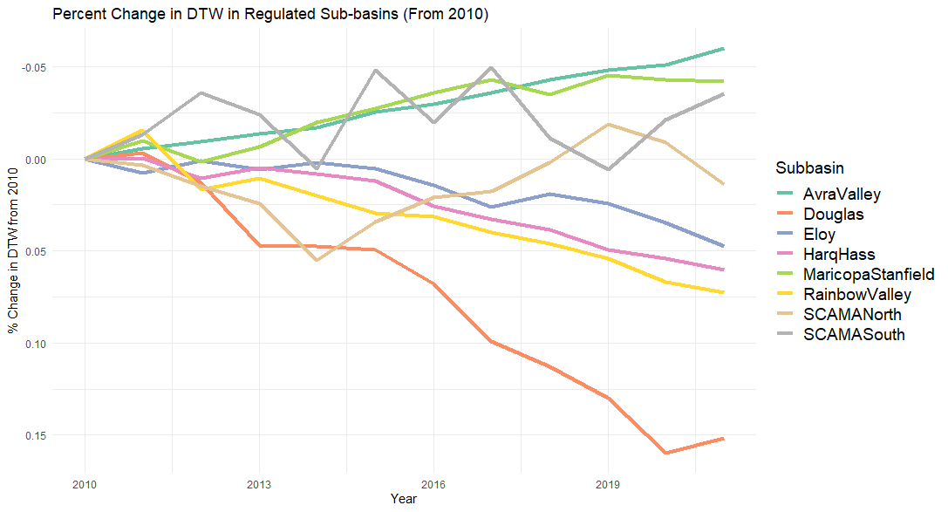
Notes:
##Helps inform aspects of the empirical model

Slide 11
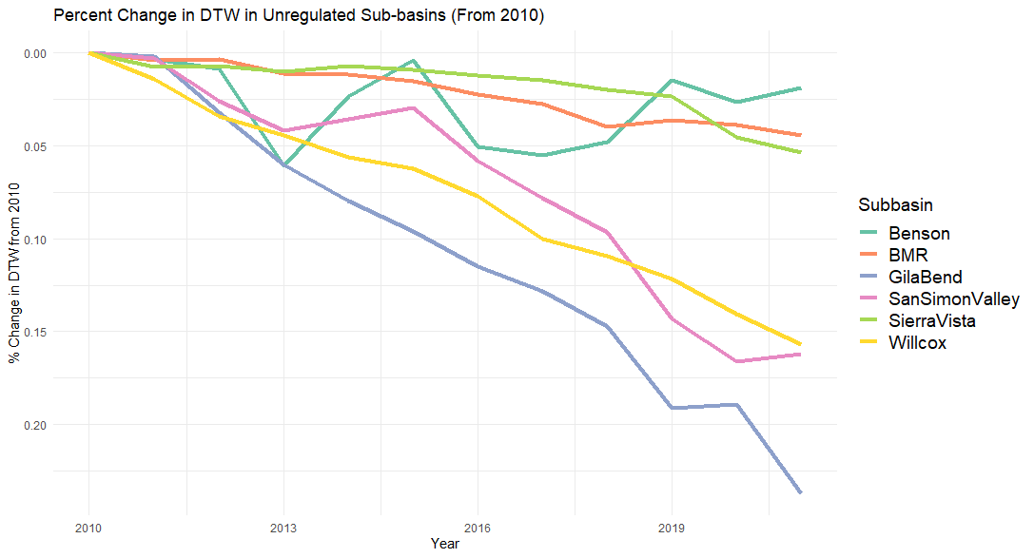
Notes:
##Helps inform aspects of the empirical model

Slide 12
Econometric Model
12 years & 14 sub-basins makes 168 observations (balanced panel)
Pooled OLS employed to allow time varying & unvarying variables
Endogeneity present
Incorporate correlated random effects (17, 18, 19)
Year controls, sub-basin specific time averages, & trend effects
Wooldridge (2021) finds estimators equate to Two-Way Fixed Effects model in linear balanced panel case
Planted acreage likely behaves differently in GW regulated sub-basins
Interaction between planted acreage and regulation status used to isolate relationship in unregulated areas
$$DTW_{it}=ρ+α_{t}{Year}_{t}+β_{1}Unreg_{i}+β_{2}Plant_{it}∗Unreg_{i}+β_{3}Plant_{it}+β_{4}Recharge_{it}+β_{5}PerCapInc_{it}+β_{6}House_{it}+β_{7}Temp_{it}+β_{8}Precip_{it}+σ_{i}U_{i}+π_{i}T_{t+1}+e_{it}$$
Notes:
##OLS model shows interactions btwn DTW and others while also seeing regulation aspect (time constant)
##CRM include year controls to control for unobservables over time not space, sub-basin specific time averages to account for heterogeneity between sub-basins that is time constant, and trend effects to control for unobserved heterogeneity that varies over space and time
##Examples CRM’s control for: crop prices, elevation, and attitudes and political beliefs influencing gw use behavior
##In model I specify regulation status as unregulated for easier interpretation purposes

Slide 13
Dependent Variable: DTW | Model (1) |  |  | Model (2) |  | Model (3) |  | Model (4)
term |  | estimate |  | estimate |  | estimate |  | estimate
Unregulated (yes = 1) |  | 67.14 | *** | 57.34 | *** | 37.80 | *** | 55.86 | ***
 |  | (10.31) |  | (10.48) |  | (11.08) |  | (15.49)
Planted Acreage * Unregulated |  | 0.11 | *** | 0.12 | *** | 0.17 | *** | 0.11 | **
 |  | (0.03) |  | (0.03) |  | (0.03) |  | (0.04)
Planted Acreage (Scaled 100 Acres) |  | 0.01 |  | 0.00 |  | -0.010 |  | -0.09
 |  | (0.01) |  | (0.01) |  | (0.11) |  | (0.07)
Recharge Project (yes = 1) |  | -13.59 |  | -10.44 |  | -4.52 |  | -19.57 | *
 |  | (9.07) |  | (9.98) |  | (12.16) |  | (10.02)
Per Capita Income (Scaled $1000) |  | -0.49 |  | -1.08 |  | -0.28 |  | -1.58
 |  | (0.88) |  | (0.91) |  | (2.19) |  | (1.53)
Housing Units |  | 0.062 | *** | 0.07 | *** | 0.005 |  | -0.029
 |  | (0.01) |  | (0.01) |  | (0.04) |  | (0.02)
Temperature |  | 11.55 | *** | 7.83 | *** | -0.98 |  | -6.39
 |  | (1.43) |  | (1.78) |  | (14.15) |  | (6.22)
Precipitation |  | -43.91 | *** | -106.24 | *** | 2.37 |  | -21.25
 |  | (14.92) |  | (25.93) |  | (39.38) |  | (18.40)
(Intercept) |  | -621.06 | *** | -285.81 | * | 132.48 |  | 96.33
 |  | (107.46) |  | (143.38) |  | (169.06) |  | (201.97)
Year Effects |  | No |  | Yes |  | Yes |  | Yes
Sub-basin Specific Time Average Effects |  | No |  | No |  | Yes |  | Yes
Time Trend Effects |  | No |  | No |  | No |  | Yes
Observations |  | 168 |  | 168 |  | 168 |  | 168
R2 |  | 0.6956 |  | 0.7436 |  | 0.7931 |  | 0.9597
Adj. R2 |  | 0.6803 |  | 0.7107 |  | 0.7583 |  | 0.9482
F Stat (8;df=159) | (19;df=148) | (24;df=143) | (37;df=130) |  | 45.42 | *** | 22.59 | *** | 22.83 | *** | 83.66 | ***
*p<0.1;**p<0.05;***p<0.01
Notes:
Breusch pagan test employed to test for heteroskedasticity and is found to likely be present. All models run with robust standard errors.
##Discussing correlations
Trend effects pick up most variation in gw levels compared to other controls
##Explain time averages here

Slide 14
Summary of Statistical Results (Model 4)
Unregulated sub-basins have increasing DTW that is 55.86 feet larger than regulated sub-basins on average over study period
Unregulated sub-basins where planted acreage increases 100 acres also increase in DTW by 0.11 feet larger than regulated sub-basins on average over study period
Sub-basins with recharge project are also those with decreasing DTW that is 20-foot larger than those with no project
Notes:
Roughly 56 feet economically significant as largest dtw on average for a subbasin is about 340 ft. Most are within 200 to 300 feet over time on average.
Planted acreage: 100 acres is still not much, considering average planted acreage among all subbasins over time is 31,304 acres
- does not change as much in regulated sub-basins but crop mix can still change
Recharge: 20-foot decrease not big over 12 years, still preventing DTW increases over time which is economically significant

Slide 15
Summary of Statistical Results (Models 1 & 2)
Sub-basins with increasing housing units increase in DTW on average over time
Sub-basins with increasing temperature increase in DTW on average over time
Sub-basins with increasing precipitation decrease in DTW on average over time
Statistical significance drops in Model 3 & 4 because housing & climate are highly correlated with time average and trend effects

Slide 16

GW Policy Implications
Results highlight need for expanding GW regulation
Results for climate variables emphasize need for continuing GW policy as climate change increases
Efforts to curb household water use are needed as population grows in rural AZ areas
Notes:
Begin: Understanding how economic, climate, and regulatory factors correlate with GW levels can help inform these policy decisions, especially where it is challenging or impossible to obtain water extraction data or estimations based on hydrologic models, remote sensing tools, or proxies, such as energy use to pump GW

Slide 17
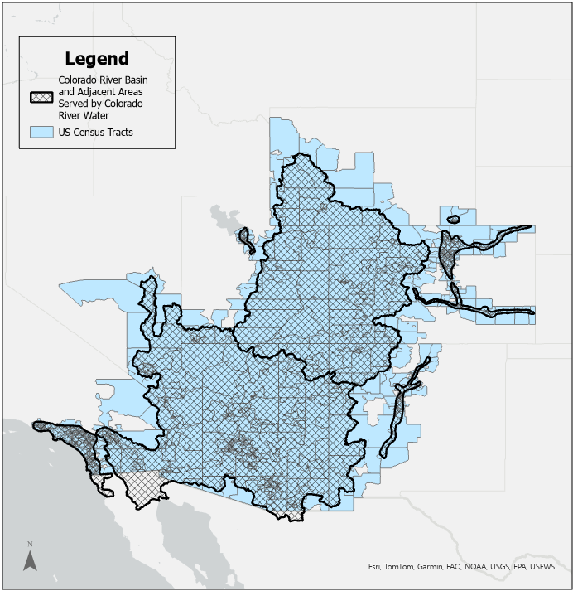
Notes:
Transition slide, show graphic from one study area zooming out to CRB.

Slide 18
Environmental Justice Considerations in the Colorado River Basin
Zoey Reed-Spitzer
May 22, 2024

Slide 19
Social & Environmental Justice in Colorado River Basin
Environmental burdens in CRB include lack of access to green space, clean air, safe drinking water, & complete household water infrastructure
Important for protecting quality & quantity of water supply & supporting well-being of water users
Environmental burdens impose adverse health outcomes (20, 21, 22, 23, 24, 25, 26)
Investigating whether certain groups disproportionately exposed to burdens

Slide 20
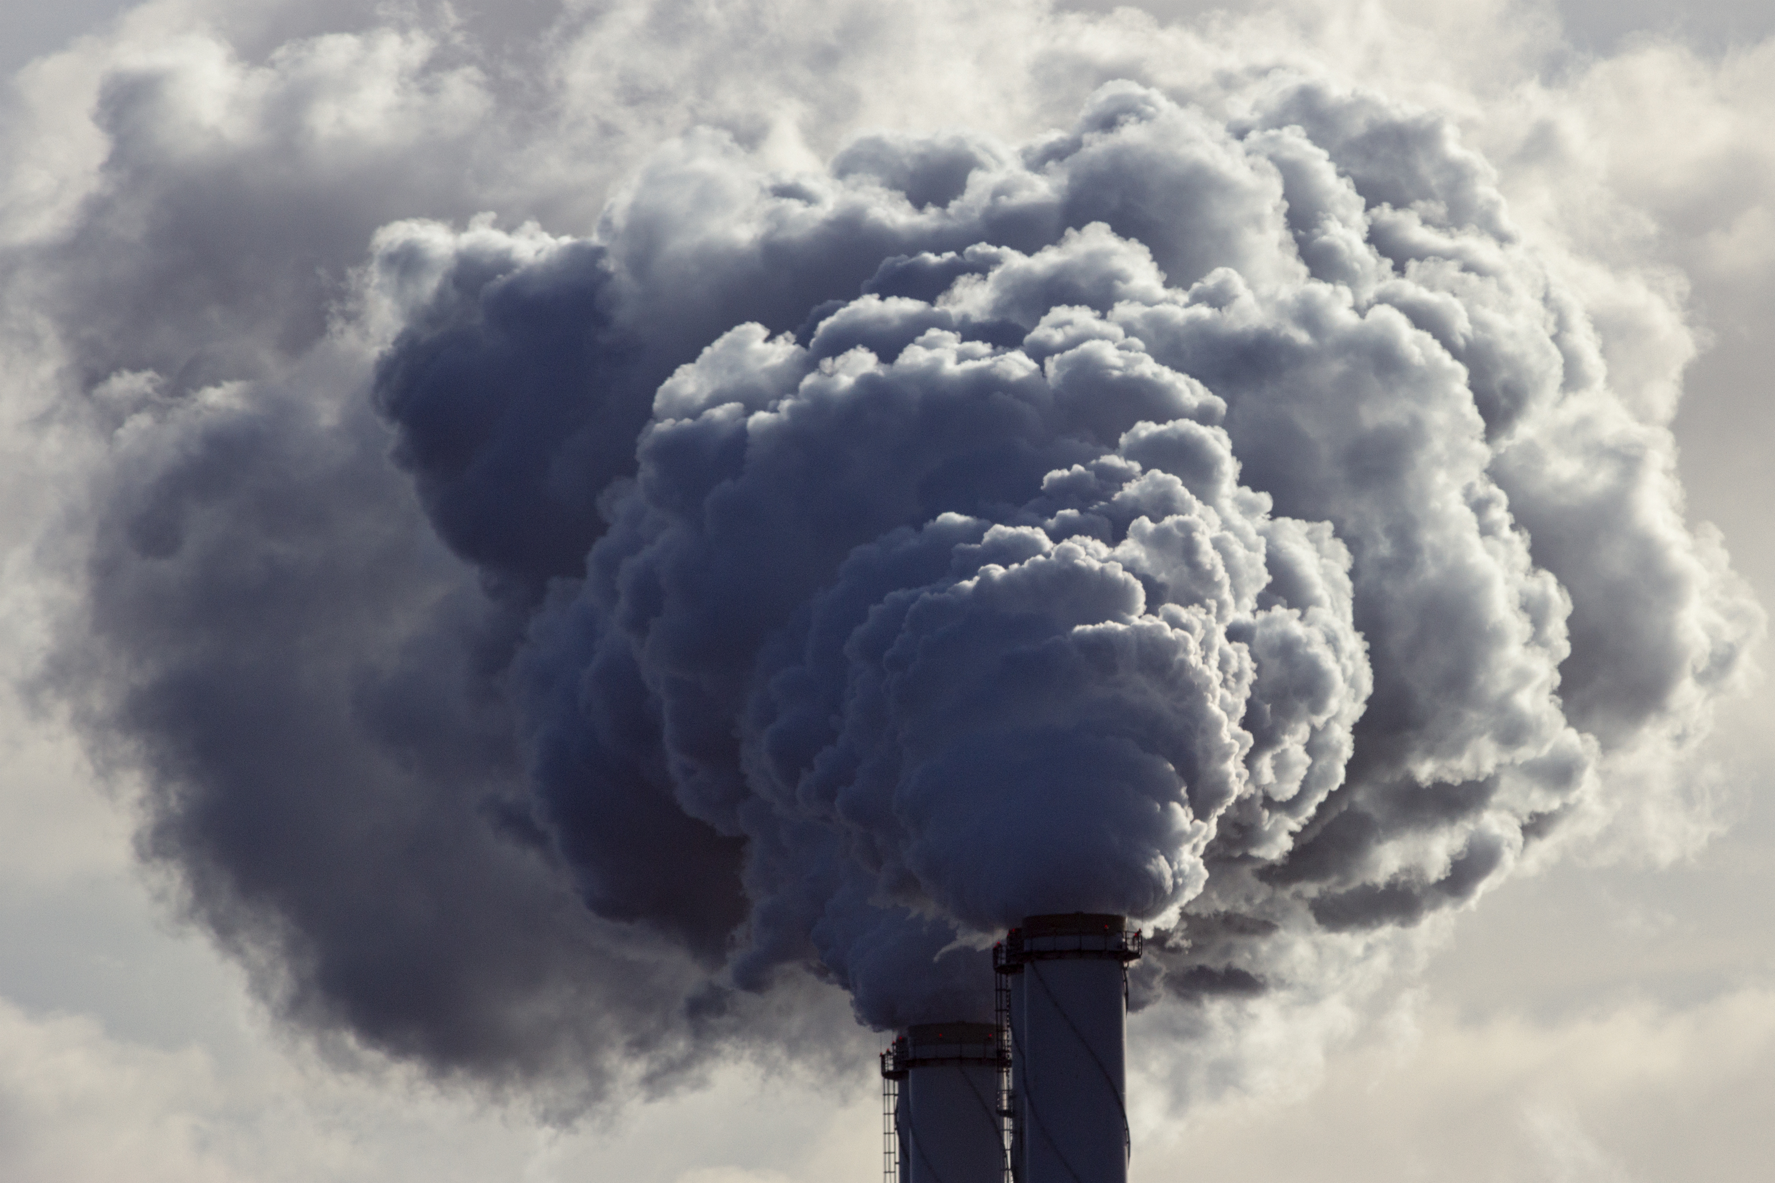

Environmental Justice Literature
Burdens lead to adverse health outcomes hindering productivity & income equality (20, 21, 22, 23; 24, 25, 26, 27)
Mitigation strategies’ disproportional outcomes
Tree canopy and green space less likely to be located in communities with higher minority populations (28, 29)
Tree planting programs → gentrification in NYC (30)

Slide 21
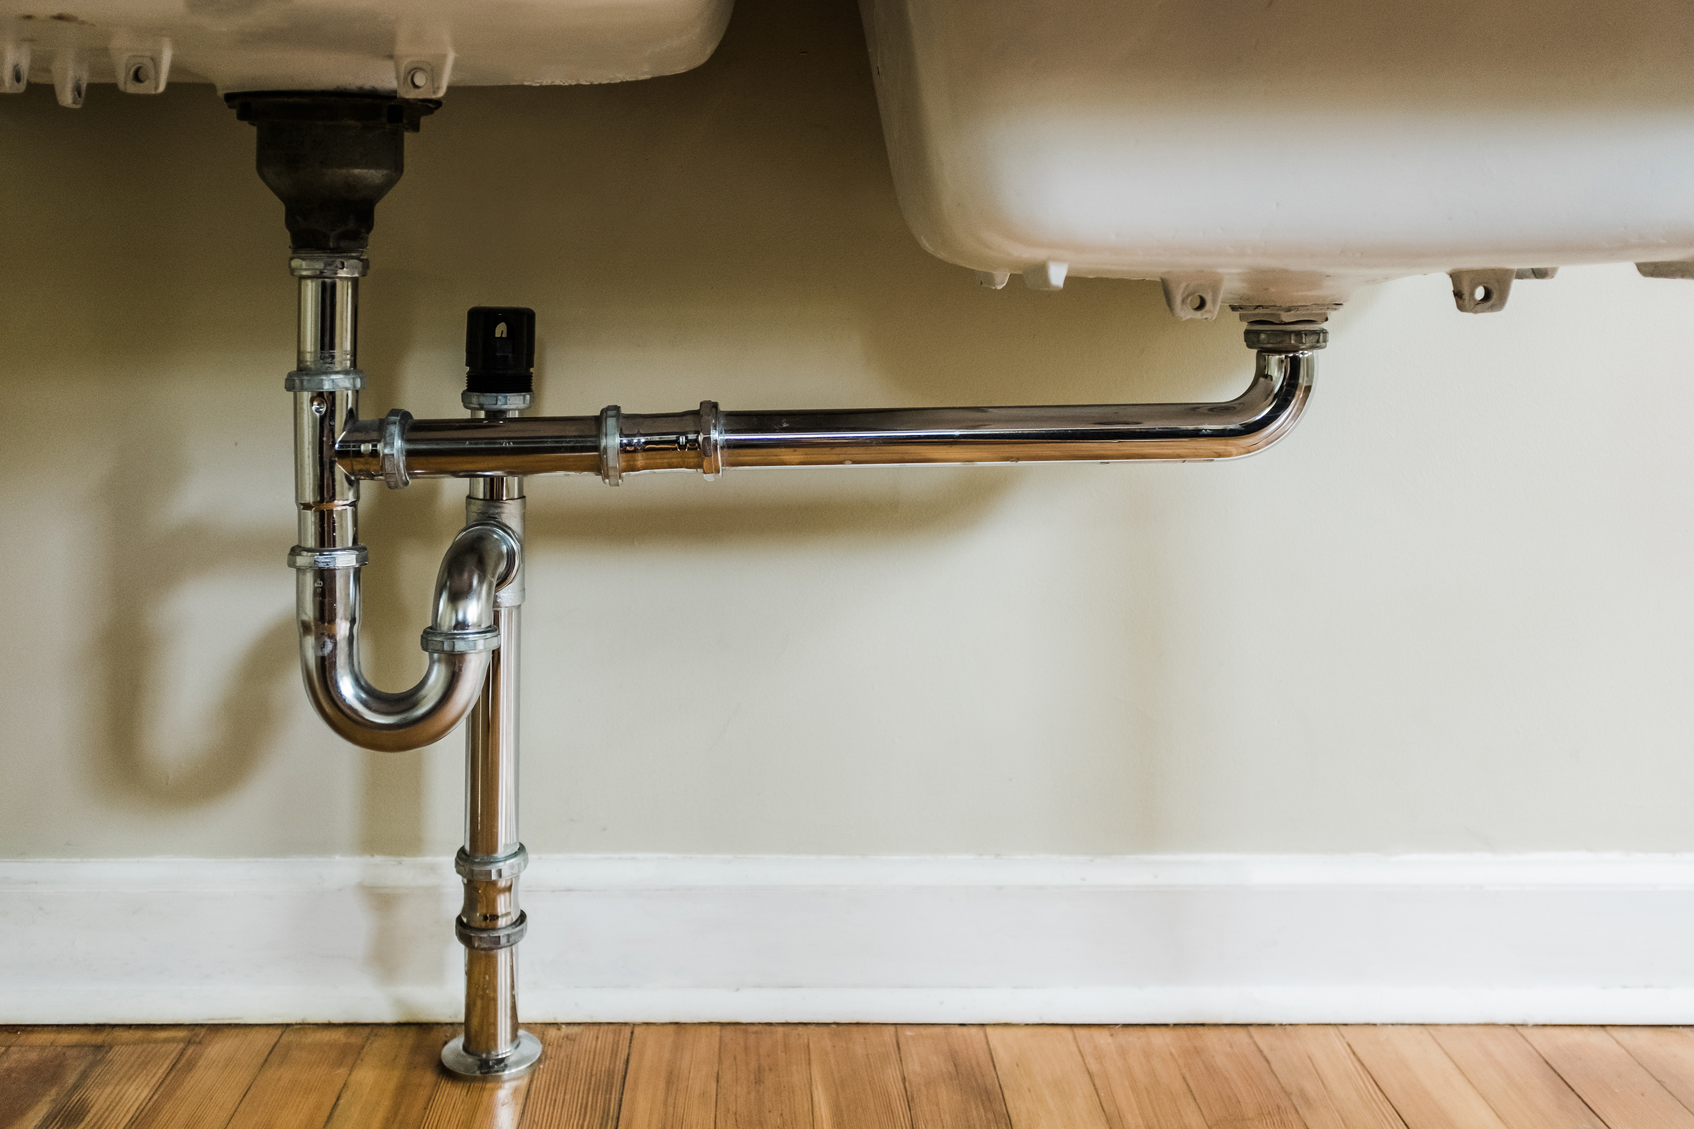

Environmental Justice Literature
Negative impacts of air & water pollution fall more on low-income & racial/ethnic minorities (24, 26, 31, 32, 33)
Poor water infrastructure in cities and households increases vulnerability to natural disasters, exposure to lead, and inhibits full water right use (34, 35, 36, 37)
This chapter adds to the literature by utilizing newly released data set by Council on Environmental Quality (CEQ) in 2022
Notes:
Pollution: Much of the studies look at Safe drinking water violations and air pollution prevalence both of which found to occur in areas with higher minority populations.
New CEQ data compliles environmental burdens with race, ethnicity, income, education, & health characteristics

Slide 22
Environmental Burden | Definition | Measurement Units | Years Available in CEJST
Lack of Green Space | The ranking out of 100 in the entire U.S. of land area size that is artificial surface (i.e. cement, roads, etc.), excluding cropland. | Percentile | 2019
Households with Incomplete Plumbing | The percent of households with incomplete kitchens or plumbing. | Percent | 2018
Leaky Underground Storage Tanks (USTs) | The density of leaky USTs and all active USTs within 1500 feet of each census tract. | Density | 2021
PM2.5 in the Air | The amount of inhalable particles, less than 2.5 micrometers, in the air. | Micrograms per cubic meter of air | 2017
Note. Environmental burdens measured at the census tract level
Notes:
##Don’t go in depth here: Green Space example: census tract with 760 units of impervious surface falls in the 10th percentile or ranks higher than 10% of all tracts in the US
##Note: According to the U.S. Census Bureau, households with incomplete plumbing are those that lack at least one of the following characteristics: hot and cold piped water, bathtub or shower, and flushable toilet; whereas households with incomplete kitchens are those that lack a sink with a faucet, stove or gas range, and/or a refrigerator

Slide 23
Variable | Definition | Units
Race & Ethnicity | Race: Number of people who identify as White, Black, American Indian, etc. Ethnicity: Number of people who identify as Hispanic | Count
Income | Mean household income in each census tract | U.S. Dollars
Education | Percent of people aged 25 or older with no high school degree | Percent
Population Density | Population divided by acres in each census tract | Density

Slide 24
Limitations in CEJST Data
Spatial mismatches at basin edges
Include every tract that overlaps with CRB boundary regardless of size of intersection
Air pollution measurement gaps likely in rural areas (EPA fills measurement gaps with modeling) (41)
Notes:
##Air pollution gaps: rural areas subject to error or underestimation of air pollution measurements
##“To fill in the gaps in those states, state average monthly profiles for oil, natural gas, and combination sources were calculated from Energy Information Administration (EIA) data and assigned to each county/SCC combination not already covered by the OGT monthly temporal profile dataset. Coal bed methane (CBM) and natural gas liquid sources in those four states were assigned flat monthly profiles where there was not already a profile assignment in the ERG dataset.”

Slide 25
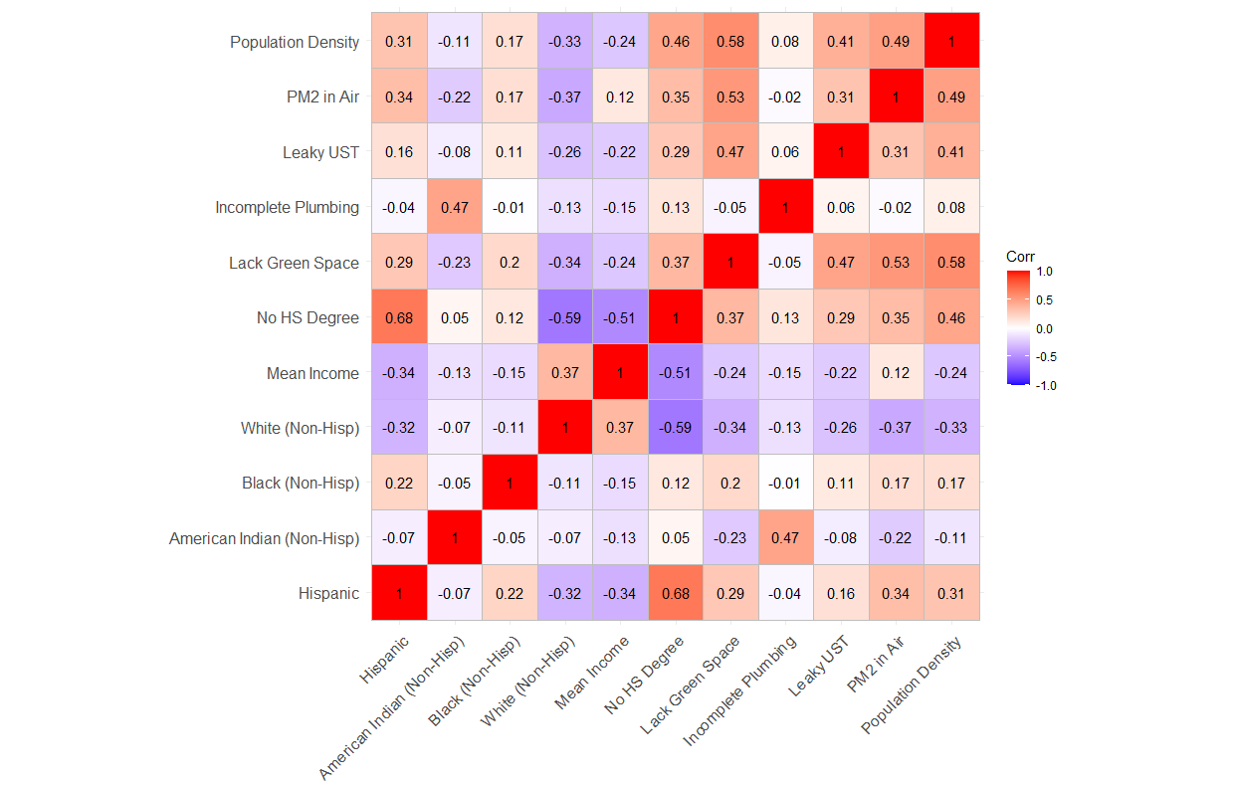
Correlations Between Environmental Burdens and Independent Variables in the CRB
Notes:
##Correlation calculated: covariance / standard deviations of each variable multiplied together.

Slide 26
Summary Statistics
Variable | Min | Mean | Median | Max | St. Dev.
Lack green space area | 3.0 | 4865.0 | 5249.0 | 9729.0 | 2235.9
Households with incomplete plumbing | 0.00% | 0.97% | 0.00% | 62.00% | 2.59%
Leaky USTs (density) | 0.0 | 3.4 | 2.2 | 42.2 | 4.0
PM2.5 in the air | 4.0 | 9.5 | 9.2 | 13.9 | 2.7
Hispanic (count) | 0 | 1714 | 1236 | 14901 | 1531
American Indian (count) | 0 | 69 | 1 | 7129 | 379
Black (count) | 0 | 242 | 99 | 5737 | 409
% Without high school degree | 0.0% | 15.1% | 10.0% | 75.0% | 13.9%
Mean Income | $0.00 | $91,533.29 | $81,480.00 | $434,685.00 | $45,331.38
Population | 0 | 4705 | 4421 | 38754 | 2225
Notes:
##Point out HH w/ incomplete plumbing and pop minimum
##Change green space to percentile

Slide 28
Econometric Models
7,939 observations at census tract level (cross-sectional)
Ordinary Least Squares (OLS) model employed to analyze relationship between each environmental burden & demographics, income, & education
Race & ethnicity found to correlate with income & education (38, 39)
Variance inflation factor (VIF) calculated to ensure variance not overinflated due to collinearity between explanatory variables (40)
State fixed effects included to avoid endogeneity from unobserved heterogeneity between census tracts
Four models analyzed with same explanatory variables & different environmental burden as dependent variable
Notes:
State fixed effects: Example) attitudes and preferences towards burdens, political beliefs, & amenities available

Slide 29
Dependent Variable: | Incomplete Plumbing |  | Leaky USTs |  | PM2.5 in the Air |  | Lack Green Space
Variable | Estimate |  | Estimate |  | Estimate |  | Estimate
(Intercept) | 0.0093 | *** | 2.21 | *** | 6.25 | *** | 55.37 | ***
 | (0.001) |  | (0.14) |  | (0.061) |  | (1.17)
Hispanic | -0.000003 | *** | -0.00025 | *** | 0.00007 | *** | 0.00037
 | (0.0000004) |  | (0.00004) |  | (0.00002) |  | (0.00023)
American Indian (non-Hisp) | 0.000032 | *** | -0.00057 | *** | -0.00043 | *** | -0.012 | ***
 | (0.000003) |  | (0.0001) |  | (0.00004) |  | (0.00066)
Black (non-Hisp) | 0.000000005 |  | 0.00031 | ** | 0.00045 | *** | 0.0029 | ***
 | (0.000001) |  | (0.0001) |  | (0.00003) |  | (0.00049)
% No HS Degree | 0.00022 | *** | 0.036 | *** | 0.023 | *** | 0.064 | **
 | (0.0001) |  | (0.0058) |  | (0.0017) |  | (0.029)
Mean Income (scaled $10,000) | -0.0000005 | *** | -0.00013 | *** | 0.00006 | *** | -0.0010 | ***
 | (0.0000001) |  | (0.000009) |  | (0.000004) |  | (0.00007)
Population Density (scaled 1000) | 0.16 | *** | 91.27 | *** | 30.02 | *** | 919.34 | ***
 | (0.037) |  | (7.54) |  | (1.94) |  | (49.02)
State Effects | Yes |  | Yes |  | Yes |  | Yes
Observations | 7939 |  | 7939 |  | 7939 |  | 7939
R2 | 0.2617 |  | 0.2138 |  | 0.7814 |  | 0.4417
Adj. R2 | 0.2606 |  | 0.2126 |  | 0.781 |  | 0.4409
F Stat (12; df = 7926) | 234.2 | *** | 179.6 | *** | 2360 | *** | 522.7 | ***
Notes:
##Mention VIF under 3 and robust standard errors due to heteroskedasticity (residual variance is not constant)

Slide 30
Summary of Statistical Findings
Racial and ethnic minorities more likely to live in areas with higher environmental burden prevalence
Higher income communities experience less environmental burden, but air pollution pervasive
Lower educated individuals more likely to live in communities with higher prevalence of each burden
More densely populated areas have higher environmental burden prevalence

Slide 31

Policy Implications
Environmental policies targeting cities may be useful
Policies targeted towards low-income, less educated communities needed to lessen disproportional environmental burdens
Emphasizing ways to limit potential gentrification effects
Notes:
Begin: We’ve been aiming to Understand which groups are likely vulnerable to the four environmental burdens examined can help inform policy regarding where to target water allocations, air pollution mitigation strategies, and investments in water quality and household infrastructure.
Second: Results align with past literature looking at disproportional outcomes on minority groups or people with lower income and less educated
Targeting cities: as places with higher population density are also places with higher env burden prevalence

Slide 32
Future Research Directions
As remote sensing products continue to become available
Extend study area, for areas that prompt use for GW level analysis, & time period
Explore relationships with environmental burdens & demographics over time with panel data
Explore relationship between income and DTW, as income may have competing effects on groundwater use behavior
Because there are gaps between air pollution monitoring stations, further analysis of air pollution still needs to be explored at a more local level by accounting for point sources in rural areas (41)
Exploring relationships between environmental burdens & Hispanic split between white and non-white interesting to see if race alone is a larger driver for disproportional exposure
Notes:
Income & DTW relationship: people with more options for how they use GW can choose to do more or less with water (invest in pool or water efficient landscaping/newer appliances)

Slide 33
Conclusion
Analyzing relationship between DTW and climate, economic, and regulatory factors shows promise in areas that lack groundwater use data
Current GW regulation can provide insight into policy decisions regarding GW use
Especially important as housing continues to be developed in many of these unregulated areas, and as climate change persists
Further policy may be needed in CRB to address disproportional environmental burden on disadvantaged communities
While efforts are being made to lessen environmental burdens, more work towards equitable outcomes is needed
Notes:
More equitable outcomes… regardless of race and ethnicity or income and education level

Slide 34

Thank you

Slide 35
References
1. Shin, Mun-Ju, Soo-Hyoung Moon, Kyung Goo Kang, Duk-Chul Moon, and Hyuk-Joon Koh. 2020. Analysis of Groundwater Level Variations Caused by the Changes in Groundwater Withdrawals Using Long Short-Term Memory Network. Hydrology 7(3): 64. https://doi.org/10.3390/hydrology7030064
2. Li Q, SC Zipper, and T Gleeson. 2020. Streamflow depletion from groundwater pumping in contrasting hydrogeological landscapes: Evaluation and sensitivity of a new management tool. Journal of Hydrology, 590, 125568. DOI: 10.1016/j.jhydrol.2020.125568
3. Dantas, I. R. M., Delzeit, R., & Klepper, G. 2021. Economic Research on the Global Allocation of Scarce Water Resources Needs Better Data. Water Economics and Policy, 07(03), 2150013. https://doi.org/10.1142/S2382624X21500132
4. Foster, T., Brozović, N., & Butler, A. P. 2015. Analysis of the impacts of well yield and groundwater depth on irrigated agriculture. Journal of Hydrology, 523, 86–96. https://doi.org/10.1016/j.jhydrol.2015.01.032
5. Hendricks, N. P., & Peterson, J. M. 2012. Fixed Effects Estimation of the Intensive and Extensive Margins of Irrigation Water Demand. Journal of Agricultural and Resource Economics, 37(1), 1–19. JSTOR.
6. Alhassan, M., Pindilli, E. J., & Lawrence, C. B. 2020. Farmer Behavior Under Groundwater Management Scenarios: Implications for Groundwater Conservation in the Mississippi Alluvial Plain. Water Economics and Policy, 06(04), 2050009. https://doi.org/10.1142/S2382624X20500095
7. Sukcharoen, K., Golden, B., Vestal, M., & Guerrero, B. 2020. Do crop price expectations matter? An analysis of groundwater pumping decisions in Western Kansas. Agricultural Water Management, 231, 106021. https://doi.org/10.1016/j.agwat.2020.106021
8. O’Donnell, M., & Berrens, R. P. 2018. Understanding Falling Municipal Water Demand in a Small City Dependent on the Declining Ogallala Aquifer: Case Study of Clovis, New Mexico. Water Economics and Policy, 04(04), 1850015. https://doi.org/10.1142/S2382624X18500157
9. Lee, J., Nemati, M., & Dinar, A. 2022. Historical trends of residential water use in California: Effects of droughts and conservation policies. Applied Economic Perspectives and Policy, 44(1), 511–530. https://doi.org/10.1002/aepp.13149
10. Brookfield, AD, S Zipper, AD Kendall, H Ajami, and JM Deines (2024). Estimating Groundwater Pumping for Irrigation: A Method Comparison. Groundwater, 62(1), 15-33. https://doi.org/10.1111/gwat.13336

Slide 36
References
11. Brookfield, AD, S Zipper, AD Kendall, H Ajami, and JM Deines (2024). Estimating Groundwater Pumping for Irrigation: A Method Comparison. Groundwater, 62(1), 15-33. https://doi.org/10.1111/gwat.13336
12. Alam MF, P Pavelic, A Sikka, S Krishnan, M Dodiya, P Bhadaliya, and V Joshi. 2023. Energy consumption as a proxy to estimate groundwater abstraction in irrigation. Groundwater for Sustainable Development, 23, 101035. https://doi.org/10.1016/j.gsd.2023.101035
13. Martindill JR, RT Good, and FL Loge. 2021. Estimating Agricultural Groundwater Withdrawals with Energy Data. Water Resources Planning and Management, 147(5), 04021018. https://doi.org/10.1061/(ASCE)WR.1943-5452.0001348
14. Burlig F, L Preonas, and M Woerman. 2021. Energy, Groundwater, and Crop Choice. NBER Working Paper, 28706. https://doi.org/10.3386/w28706
15. Wang L, W Kinzelbach, H Yao, J Steiner, and H Wang. 2020. How to Meter Agricultural Pumping at Numerous Small-Scale Wells?—An Indirect Monitoring Method Using Electric Energy as Proxy. Water, 12(9), 2477. https://doi.org/10.3390/w12092477
16. Hurr T, and DW Litke. 1989. Estimating pumping time and ground-water withdrawals using energy- consumption data. Department of the Interior, Water-Resources Investigations Report 89-4107. https://pubs.usgs.gov/wri/1989/4107/report.pdf
17. Mundlak Y. 1978. On the pooling of time series and cross section data. Econometrica, 46(1): 69–85.
18. Wooldridge JM. 2010. Econometric Analysis of Cross Section and Panel Data (2nd Ed.). Cambridge, The MIT Press.
19. Wooldridge JM. 2021. "Two-Way Fixed Effects, the Two-Way Mundlak Regression, and Difference-in-Differences Estimators." SSRN Scholarly Paper, 3906345. DOI: 10.2139/ssrn.3906345
20. Oyedele O and SA Tella. 2023. "Environmental quality and health outcomes in sub-Saharan Africa- A panel econometric approach on the role of forest investment." Cogent Economics & Finance, 11(2), 2269806. DOI: 10.1080/23322039.2023.2269806

Slide 37
References
21. Oliveira VH, I Lee, and C Quintana-Domeque. 2023. "Natural Disasters and Early Human Development: Hurricane Catarina and Infant Health in Brazil." Journal of Human Resources, 58(3), 819-851. DOI: 10.3368/jhr.59.1.0816-8144R1
22. Johar M, DW Johnston, MA Shields, P Siminski, and O Stavrunova. 2022. "The economic impacts of direct natural disaster exposure." Journal of Economic Behavior & Organization, 196, 26-39. DOI: 10.1016/j.jebo.2022.01.023
23. González FAI, ME Santos, and S London. 2021. "Persistent effects of natural disasters on human development: quasi-experimental evidence for Argentina." Environment, Development and Sustainability, 23(7), 10432-10454. DOI: 10.1007/s10668-020-01064-7
24. Jorgenson AK, TD Hill, B Clark, RP Thombs, P Ore, KS Balistreri, and JE Givens. 2020. "Power, proximity, and physiology: does income inequality and racial composition amplify the impacts of air pollution on life expectancy in the United States?." Environmental Research Letters, 15(2), 024013. DOI: 10.1088/1748-9326/ab6789
25. Spotswood EN, M Benjamin, L Stoneburner, MM Wheeler, EE Beller, D Balk, T McPhearson, M Kuo, and RI McDonald. 2021. "Nature inequity and higher COVID-19 case rates in less-green neighbourhoods in the United States." Nature Sustainability, 4(12), 1092-1098. DOI: 10.1038/s41893-021-00781-9
26. Dell M, BF Jones, and BA Olken. 2009. "Temperature and Income: Reconciling New Cross-Sectional and Panel Estimates." American Economic Review, 99(2), 198-204. DOI: 10.1257/aer.99.2.198
27. Zaveri ED, JD Russ, SG Desbureaux, R Damania, AS Rodella, and G Ribeiro Paiva De Souza. 2024. "The Nitrogen Legacy: The Long-Term Effects of Water Pollution on Human Capital." World Bank Policy Research Working Paper No. 9143. https://papers.ssrn.com/sol3/papers.cfm?abstract_id=3533562
28. Williams TG, TM Logan, CT Zuo, KD Liberman, and SD Guikema. 2020. "Parks and safety: a comparative study of green space access and inequity in five US cities." Landscape and Urban Planning, 201, 103841. DOI: 10.1016/j.landurbplan.2020.103841
29. Zhang Z, KL Martin, KT Stevenson, and Y Yao. 2022. "Equally green? Understanding the distribution of urban green infrastructure across student demographics in four public school districts in North Carolina, USA." Urban Forestry & Urban Greening, 67, 127434. DOI: 10.1016/j.ufug.2021.12743
30. Li L. 2023. "Environmental goods provision and gentrification: Evidence from MillionTreesNYC." Journal of Environmental Economics and Management, 120, 102828. DOI: 10.1016/j.jeem.2023.102828

Slide 38
References
31. Kodros JK, ML Bell, F Dominici, C L'Orange, KJ Godri Pollitt, S Weichenthal, X Wu, and J Volckens. 2022. "Unequal airborne exposure to toxic metals associated with race, ethnicity, and segregation in the USA." Nature Communications, 13(1), 6329. DOI: 10.1038/s41467-022-33372-z
32. Kathuria V and NA Khan. 2007. "Vulnerability to Air Pollution: Is There Any Inequity in Exposure?" Economic and Political Weekly, 42(30), 3158-3165. https://www.jstor.org/stable/4419846
33. Bell ML and K Ebisu. 2012. "Environmental Inequality in Exposures to Airborne Particulate Matter Components in the United States." Environmental Health Perspectives, 120(12), 1699-1704. DOI: 10.1289/ehp.1205201
34. Deria A, P Ghannad, and YC Lee. 2020. "Evaluating implications of flood vulnerability factors with respect to income levels for building long-term disaster resilience of low-income communities." International Journal of Disaster Risk Reduction, 48, 101608. DOI: 10.1016/j.ijdrr.2020.101608
35. Nigra AE, W Lieberman-Cribbin, BC Bostick, ST Chillrud, and D Carrion. 2023. "Geospatial Assessment of Racial/Ethnic Composition, Social Vulnerability, and Lead Water Service Lines in New York City." Environmental Health Perspectives, 131(8), 087015. DOI: 10.1289/EHP12276
36. Bandala ER, MI McCarthy, and N Brune. 2022. "Water security in native American communities of Nevada." Environmental Science & Policy, 136, 520-529. DOI: 10.1016/j.envsci.2022.07.009
37. Sanchez L, B Leonard, and EC Edwards. 2023. "Paper Water, Wet Water, and the Recognition of Indigenous Property Rights." Journal of the Association of Environmental and Resource Economists, 10(6), 1545-1579. DOI: 10.1086/725400
38. Chetty R, N Hendren, MR Jones, and SR Porter. (2020). “Race and Economic Opportunity in the United States: an Intergenerational Perspective.” The Quarterly Journal of Economics, 135(2), 711-783. DOI: 10.1093/qje/qjz042
39. Oh B, N Tilbrook, and D Shifrer. (2024). “Shifting Tides: The Evolution of Racial Inequality in Higher Education from the 1980s through the 2010s.” Socius, 10, 23780231231225578. DOI: 10.1177/23780231231225578
40. Michler, J. D., & Wu, S. Y. 2020. Governance and contract choice: Theory and evidence from groundwater irrigation markets. Journal of Economic Behavior and Organization, 180, 129-147. https://doi.org/10.1016/j.jebo.2020.09.031

Slide 39
References
41. US Environmental Protection Agency. 2020. "Bayesian Space-time Downscaling Fusion Model (Downscaler) - Derived Estimates of Air Quality for 2017." Office of Air Quality Planning and Standards Air Quality Assessment Division.
42. Bernat, R (2024). Private communication. January 25, 2024.
43. Central Arizona Project. n.d.. History of CAP. https://www.cap-az.com/about/history-of-cap/
44. ADWR. n.d.b. Active Management Areas. https://new.azwater.gov/ama

Slide 40
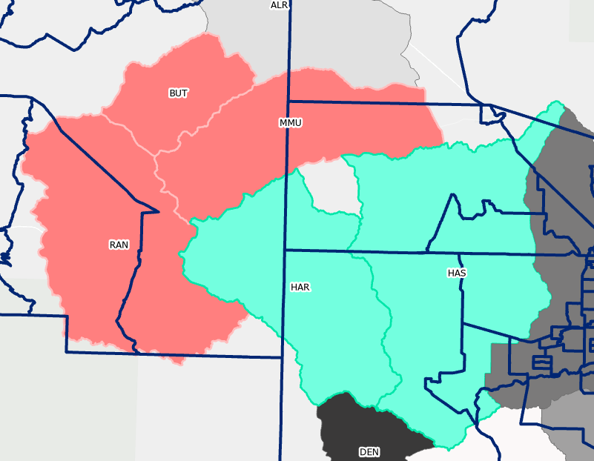
Census Data and Sub-basin Boundary Spatial Mismatch Example

Slide 41
Sub-basin | Cotton | Major Grains | Other Crops | Tree Crops | Alfalfa
Benson | 210 | 451 | 16 | 139 | 1078
Douglas | 299 | 11534 | 498 | 3381 | 4022
Gila Bend | 835 | 10097 | 1970 | 3 | 41304
Harquahala INA & Hassayampa | 2077 | 3423 | 337 | 1 | 30804
SCAMA North | 77 | 33 | 1 | 229 | 617
SCAMA South | 62 | 47 | 0 | 94 | 265
Willcox | 2145 | 37033 | 3913 | 5756 | 9628
Sierra Vista | 9 | 33 | 4 | 231 | 101
Avra Valley | 11255 | 5286 | 27 | 898 | 3988
Butler & McMullen Valley, Ranegras Plains | 270 | 7858 | 5554 | 61 | 15481
Eloy | 53660 | 21780 | 4149 | 1582 | 35747
Maricopa-Stanfield | 13130 | 25256 | 8846 | 915 | 35814
Rainbow Valley | 24 | 1878 | 655 | 0 | 3722

Slide 42
Well Counts in DTW Calculation by Sub-basin
Sub-basin | Basin | Number of Wells
Benson | Upper San Pedro* | 5
Douglas | Douglas AMA | 15
Gila Bend | Gila Bend* | 12
Harquahala INA & Hassayampa | Harquahala Basin & Phoenix AMA | 44
Santa Cruz AMA North | Santa Cruz AMA | 16
Santa Cruz AMA South | Santa Cruz AMA | 24
Sierra Vista | Upper San Pedro* | 36
Willcox | Willcox* | 26
Avra Valley | Tucson AMA | 45
Eloy | Pinal AMA | 74
Maricopa-Stanfield | Pinal AMA | 27
Rainbow Valley | Phoenix AMA | 11
Butler Valley, McMullen Valley, Ranegras Plain | Butler Valley, McMullen Valley, & Ranegras Plain* | 40
San Simon Valley | Safford Basin* | 19
*Groundwater not regulated

Slide 43
 | DTW (Acre Ft.) |  | Temperature (C) |  | Precipitation (in)
Sub-basin | Mean | St. dev. | Mean | St. dev. | Mean | St. dev.
Avra Valley | 245.64 | 4.96 | 19.80 | 0.49 | 1.07 | 0.26
Butler, McMullen, & Ranegras* | 340.84 | 5.27 | 20.87 | 0.53 | 0.56 | 0.14
Benson* | 241.44 | 5.19 | 17.60 | 0.51 | 1.14 | 0.26
Douglas | 190.00 | 10.10 | 17.32 | 0.57 | 1.08 | 0.25
Eloy | 239.24 | 3.55 | 21.74 | 0.51 | 0.72 | 0.19
Gila Bend* | 325.16 | 22.42 | 22.68 | 0.46 | 0.55 | 0.13
Harquahala INA & Hassayampa | 217.01 | 4.64 | 21.51 | 0.56 | 0.60 | 0.16
Maricopa Stanfield | 314.16 | 5.74 | 22.18 | 0.52 | 0.59 | 0.15
Rainbow Valley | 365.18 | 9.39 | 22.27 | 0.54 | 0.59 | 0.15
SCAMA North | 66.79 | 1.30 | 17.82 | 0.45 | 1.36 | 0.28
SCAMA South | 94.17 | 1.83 | 17.43 | 0.43 | 1.38 | 0.29
San Simon Valley* | 197.51 | 10.97 | 16.71 | 0.49 | 1.05 | 0.23
Sierra Vista* | 227.03 | 3.62 | 16.99 | 0.52 | 1.29 | 0.30
Willcox* | 264.00 | 12.24 | 16.16 | 0.53 | 1.25 | 0.27
 | Planted Acreage (Acres) |  | Per Capita Income (USD) |  | Housing Units
Sub-basin | Mean | St. dev. | Mean | St. dev. | Mean | St. dev.
Avra Valley | 21,990 | 1,587 | 22,352.06 | 2,369.90 | 1,892 | 88
Butler, McMullen, & Ranegras* | 24,586 | 6,840 | 25,772.86 | 4,113.00 | 1,812 | 205
Benson* | 1,523 | 470 | 23,886.50 | 3,356.59 | 2,052 | 215
Douglas | 16,680 | 1,911 | 16,851.72 | 1,846.78 | 1,467 | 118
Eloy | 127,622 | 5,736 | 18,425.70 | 2,339.49 | 1,780 | 146
Gila Bend* | 49,242 | 7,174 | 7,681.20 | 861.63 | 523 | 31
Harquahala INA & Hassayampa | 37,773 | 4,442 | 23,917.57 | 1,618.33 | 1,861 | 239
Maricopa Stanfield | 86,391 | 3,096 | 29,668.07 | 1,784.95 | 1,675 | 40
Rainbow Valley | 4,446 | 1,815 | 24,026.58 | 5,438.16 | 1,844 | 396
SCAMA North | 970 | 343 | 32,871.42 | 4,376.04 | 1,678 | 144
SCAMA South | 553 | 169 | 17,521.43 | 2,047.94 | 1,573 | 155
San Simon Valley* | 14,882 | 2,899 | 20,668.08 | 1,379.98 | 1,150 | 236
Sierra Vista* | 525 | 303 | 28,745.19 | 2,145.61 | 2,096 | 139
Willcox* | 51,071 | 4,963 | 20,651.83 | 1,425.33 | 1,442 | 92
*GW not regulated

Slide 44
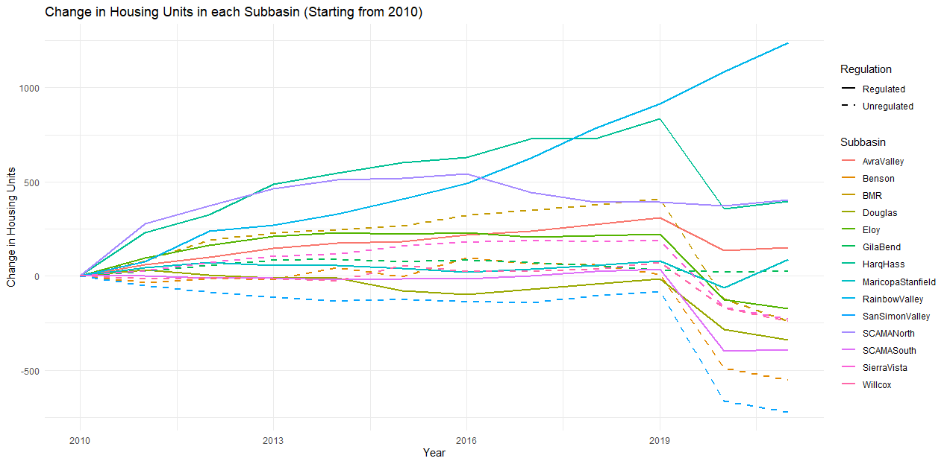

Slide 45
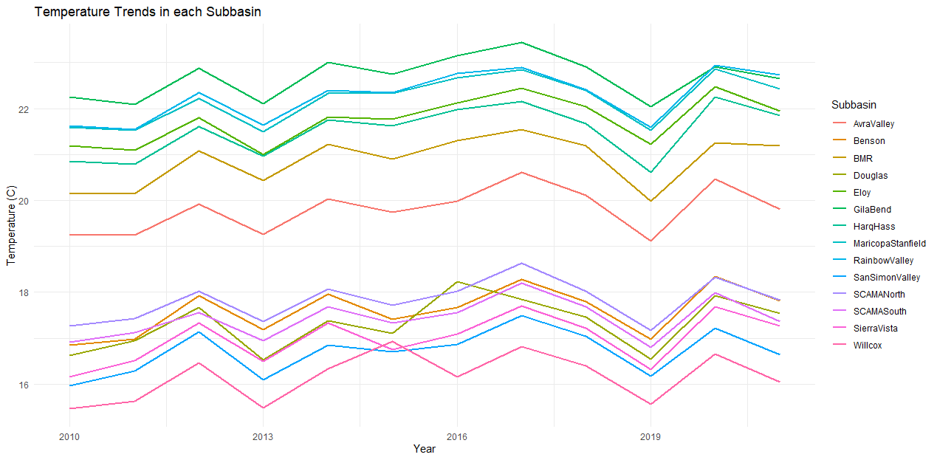

Slide 46
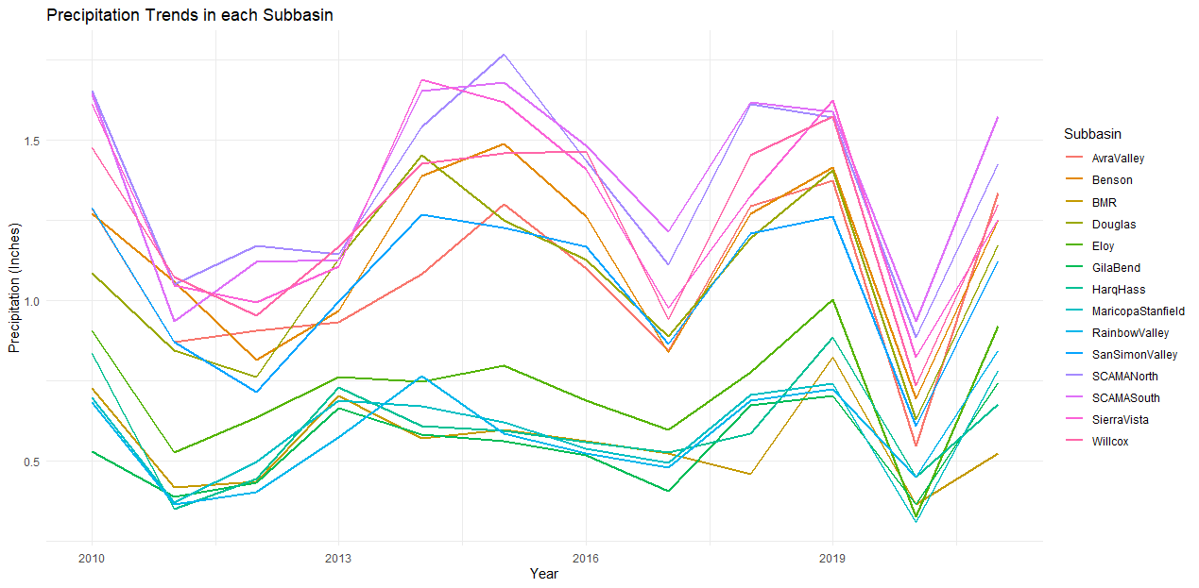

Slide 47
ACS Population Breakdown
White
People of Color (Black, Asian, etc.)
Non-Hispanic or Latino
White
Ethnicity
Race
People of Color (Black, Asian, etc.)
Hispanic or Latino
Two Categories:

Slide 49
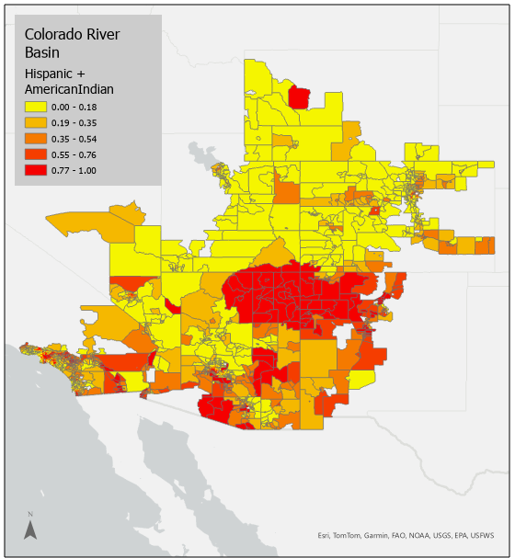

Slide 50
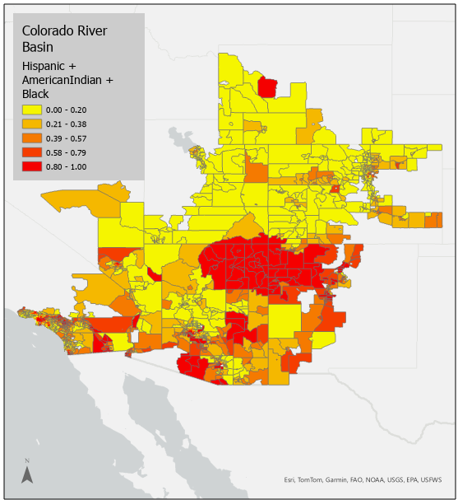

Slide 51
Dependent Variable: | Incomplete Plumbing
 | (1) |  | (2) No Pop |  | (3) No HS |  | (4)
Variable | estimate |  | estimate |  | estimate |  | estimate
(Intercept) | 0.01433 | *** | 0.01029 | *** | 0.0121 | *** | 0.0093 | ***
 | 0.00116 |  | 0.00094 |  | 0.0012 |  | 0.0010
Hispanic | -0.000002 | *** | -0.000003 | *** | -0.0000019 | *** | -0.000003 | ***
 | 0.000000 |  | 0.000000 |  | 0.0000002 |  | 0.000000
American Indian (Non-Hisp) | 0.000032 | *** | 0.000031 | *** | 0.0000326 | *** | 0.000032 | ***
 | 0.000003 |  | 0.000003 |  | 0.0000034 |  | 0.000003
Black (Non-Hisp) | -0.0000002 |  | 0.0000004 |  | -0.0000006 |  | 0.000000005
 | 0.000001 |  | 0.0000013 |  | 0.0000012 |  | 0.00000124
Mean Income (scaled $10,000) | -0.000001 | *** | -0.0000005 | *** | -0.0000007 | *** | -0.0000005 | ***
 | 0.000000 |  | 0.000000 |  | 0.0000001 |  | 0.0000001
% No HS Degree |  |  | 0.00027 | *** |  |  | 0.0002 | ***
 |  |  | 0.00006 |  |  |  | 0.0001
Population Density (scaled 1000) |  |  |  |  | 0.2081 | *** | 0.1602 | ***
 |  |  |  |  | 0.0332 |  | 0.0373
State Effects | Yes |  | Yes |  | Yes |  | Yes
Observations | 7939 |  | 7939 |  | 7939 |  | 7939
R2 | 0.2492 |  | 0.2576 |  | 0.2567 |  | 0.2617
Adj. R2 | 0.2482 |  | 0.2566 |  | 0.2557 |  | 0.2606
F Stat (10; df=7928) | (11; df=7927) | (12; df=7926) | 263.1 | *** | 250 | *** | 248.9 | *** | 234.2 | ***

Slide 52
Dependent Variable: | Leaky UST
 | (1) |  | (2) No Pop |  | (3) No HS |  | (4)
Variable | estimate |  | estimate |  | estimate |  | estimate
(Intercept) | 3.74 | *** | 2.74 | *** | 2.66 | *** | 2.21 | ***
 | 0.14 |  | 0.14 |  | 0.14 |  | 0.14
Hispanic | -0.00001 |  | -0.0003 | *** | -0.00008 | ** | -0.0002 | ***
 | 0.00003 |  | 0.0000 |  | 0.00003 |  | 0.0000
American Indian (Non-Hisp) | -0.00063 | *** | -0.0008 | *** | -0.00044 | *** | -0.0006 | ***
 | 0.00008 |  | 0.0001 |  | 0.00007 |  | 0.0001
Black (Non-Hisp) | 0.00039 | *** | 0.0006 | *** | 0.00020 | ** | 0.0003 | **
 | 0.00012 |  | 0.0001 |  | 0.00012 |  | 0.0001
Mean Income (scaled $10,000) | -0.00024 | *** | -0.0002 | *** | -0.00016 | *** | -0.0001 | ***
 | 0.00001 |  | 0.0000 |  | 0.00001 |  | 0.0000
% No HS Degree |  |  | 0.066 | *** |  |  | 0.0359 | ***
 |  |  | 0.006 |  |  |  | 0.0058
Population Density (scaled 1000) |  |  |  |  | 99.26 | *** | 91.27 | ***
 |  |  |  |  | 7.31 |  | 7.54
State Effects | Yes |  | Yes |  | Yes |  | Yes
Observations | 7939 |  | 7939 |  | 7939 |  | 7939
R2 | 0.1346 |  | 0.1564 |  | 0.2079 |  | 0.2138
Adj. R2 | 0.1335 |  | 0.1553 |  | 0.2068 |  | 0.2126
F Stat (10; df=7928) | (11; df=7927) | (12; df=7926) | 123.3 | *** | 133.6 | *** | 189.1 | *** | 179.6 | ***

Slide 53
Dependent Variable: | PM2.5 In Air
 | (1) |  | (2) No Pop |  | (3) No HS |  | (4)
Variable | estimate |  | estimate |  | estimate |  | estimate
(Intercept) | 6.93 | *** | 6.429493 | *** | 6.55 | *** | 6.252 | ***
 | 0.06 |  | 0.0585904 |  | 0.06 |  | 0.061
Hispanic | 0.00020 | *** | 0.00004 | ** | 0.00018 | *** | 0.00007 | ***
 | 0.00001 |  | 0.00002 |  | 0.00001 |  | 0.00002
American Indian (Non-Hisp) | -0.00042 | *** | -0.00052 | *** | -0.00035 | *** | -0.00043 | ***
 | 0.00004 |  | 0.00004 |  | 0.00004 |  | 0.00004
Black (Non-Hisp) | 0.00045 | *** | 0.00053 | *** | 0.00038 | *** | 0.00045 | ***
 | 0.00003 |  | 0.00003 |  | 0.00003 |  | 0.00003
Mean Income (scaled $10,000) | 0.00001 | *** | 0.00005 | *** | 0.00004 | *** | 0.00006 | ***
 | 0.00000 |  | 0.000004 |  | 0.000004 |  | 0.00000
% No HS Degree |  |  | 0.033342 | *** |  |  | 0.02330 | ***
 |  |  | 0.0016585 |  |  |  | 0.00173
Population Density (scaled 1000) |  |  |  |  | 35.20392 | *** | 30.02 | ***
 |  |  |  |  | 2.00120 |  | 1.94
State Effects | Yes |  | Yes |  | Yes |  | Yes
Observations | 7939 |  | 7939 |  | 7939 |  | 7939
R2 | 0.7556 |  | 0.7677 |  | 0.7759 |  | 0.7814
Adj. R2 | 0.7553 |  | 0.7674 |  | 0.7756 |  | 0.781
F Stat (10; df=7928) | (11; df=7927) | (12; df=7926) | 2451 | *** | 2381 | *** | 2495 | *** | 2360 | ***

